Slide 1
BYU Professional Teacher Candidate Assessment (TCA)
September 2024

Slide 2
Why a New Evaluation Tool?
The Utah Effective Teacher Standards changed August 2023. BYU needed to replace the PAES as it was no longer aligned to the Utah Effective Teaching Standards.
Utah’s Personalized Competency Based Learning Framework (PCBL) was adopted in September 2023.
June 2024 PPAT will no longer be required for a Utah Professional License. BYU needed to replace the PPAT.
June 2024 the Utah State Board of Education (USBE) approved the Educator Preparation Program General Teacher Preparation Competencies.

Slide 3
Why the BYU Professional Teacher Candidate Assessment? (TCA)
BYU wanted to emphasize the role the BYU Aims, Mission, and the Partnership commitments play in becoming an educator through BYU.
It was determined that one tool would incorporate all BYU desired components, all USBE requirements for licensure, and national accreditation requirements.
BYU will pilot the TCA during the 2024-25 academic year.
Candidates in their final field experience must demonstrate competency in all 37 competencies to be recommended for a Utah professional educator license.

Slide 4
Scale and Items
There are twenty-two items on a 0-3 scale:
Not Effective (0)
Beginning (1)
Demonstrates Competency (2)
Exceptional (3)
There are two items on a Yes/No scale.
There are five sections identifying each of the BYU-Public School Partnership Commitments under which the USBE Educator Preparation Program General Teacher Preparation Competencies are listed.
There are five sections in which the Mentor Teacher/University Supervisor considers the competencies and commitment for each section and gives feedback to the teacher candidate.
There are five sections in which the Teacher Candidate reflects on the aspects of the BYU-Public School Partnership commitment, the competencies within that section, and the mission of BYU as it relates to their teaching experience.

Slide 5
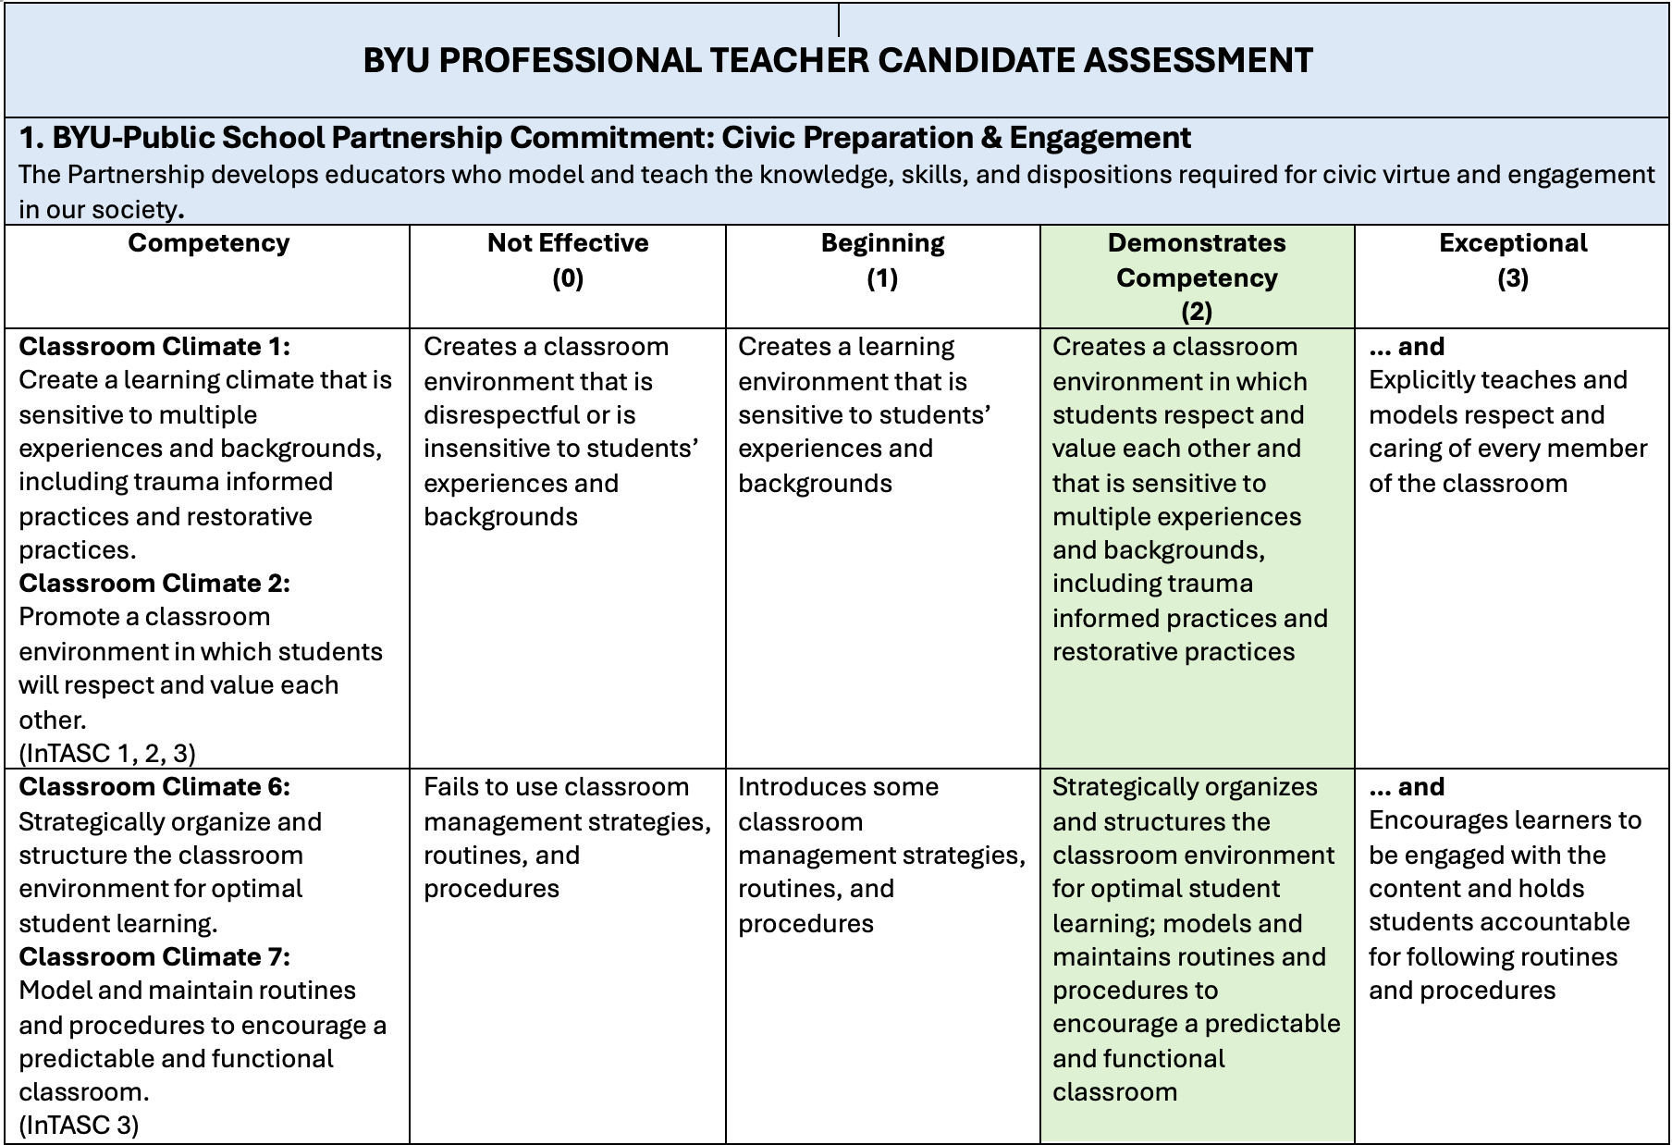
BYU-PSP Commitment
Utah State Board of Education Educator Preparation Program General Teacher Preparation Competencies

Slide 6
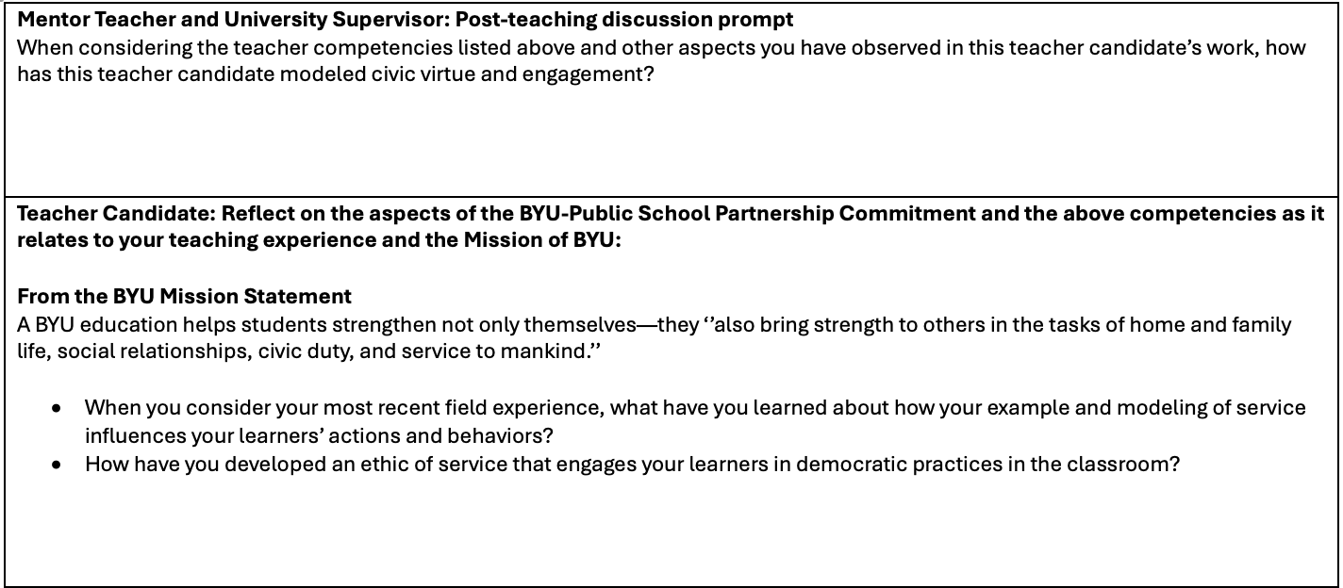
Mentor Teacher and University Supervisor Feedback given to Teacher Candidate
Teacher Candidate reflection on competencies and the mission of BYU

Slide 7
Action
Improve

Slide 8
Scoring
Practicum
During the practicum experience it is expected that candidates will score in the following two categories:
Not Effective (0)
Beginning (1)
“Demonstrates Competency (2)” and “Exceptional (3)” may also be marked but are not expected.
If the candidate is struggling and not meeting expectations, a remediation plan needs to be created, and the student’s progress must be monitored.
NOTE: These are EPP minimums. Programs may have additional requirements

Slide 9
Scoring
Final Field Experience
During the final field experience, student teaching or internship, the candidate must score in the “Demonstrates Competency (2)” column for all items in this column and must receive all “Yes” marks for the two “Yes/No” items.
Candidates can score “Exceptional (3)” during their final field experience, but they must demonstrate they are meeting all the requirements in “Demonstrates Competency (2)” AND the requirements in “Exceptional (3)”.
To pass their final field experience and be recommended for licensure, the candidate cannot receive a score of “Not Effective (0)”, “Beginning (1)” or “No” on any item in the rubric.

Slide 10
Formative Assessments
Majors
Four formative assessments using the BYU Professional Teacher Candidate Assessment will be administered, giving feedback with each formative evaluation. For a formative assessment not all items on the rubric must be marked, but by the end of the fourth formative assessment the evaluator must ensure that the candidate has demonstrated competency in all areas.
NOTE: These are EPP minimums. Programs may have additional requirements

Slide 11
Formative Assessments
Minors
Two formative assessments using the BYU Professional Teacher Candidate Assessment will be administered, giving feedback with each formative evaluation. By the end of the second formative assessment the evaluator must ensure that the candidate has demonstrated competency in all areas.

Slide 12
Summative Assessments
University Supervisors:
A summative evaluation for each field experience (i.e., practicum, student teaching, internship) will be completed by the university supervisor in Educator by marking all items of the BYU Professional Teacher Candidate Assessment, providing written feedback to the candidate in each BYU-Public School Partnership Commitment under the University Supervisor post-teaching discussion prompt, and fill out the Summary Statement section.
NOTE:
When marking the rubric, it is essential that evidence is provided of application or demonstration of the competencies listed.
Mentor Teacher summative evaluations should be taken into consideration as the university supervisor completes the summative evaluation for student teachers or interns.

Slide 13
Summative Assessments
For the final field experience (student teaching or internship) the:
Teacher candidate will fill out a self-evaluation in Educator by marking all items of the BYU Professional Teacher Candidate Assessment and providing a reflection in each BYU-Public School Partnership Commitment in the Teacher Candidate reflection section.

Slide 14
Summative Assessments (continued)
Mentor teacher will fill out a summative evaluation in Educator for the final field experience by marking all items of the BYU Professional Teacher Candidate Assessment, providing written feedback to the candidate in each BYU-Public School Partnership Commitment under the Mentor Teacher post-teaching discussion prompt, and fill out the Summary Statement section.
NOTE: When marking the rubric, it is essential that evidence is provided of application or demonstration of the competencies listed.

Slide 15
Summative Assessments
Summative Evaluations:
University supervisors summative BYU Professional Teacher Candidate Assessment will be completed around the 14th Friday of the semester (Fall or Winter) and the 7th Friday of a term (Spring or Summer) for each clinical experience (practicum, student teaching or internship) and will be entered into the Educator System.

Slide 16
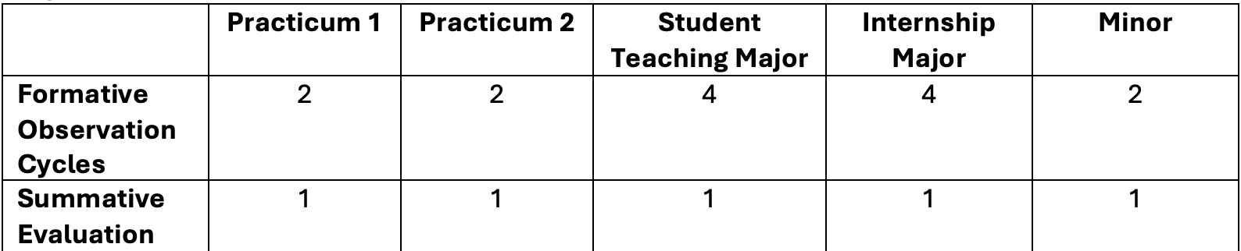
Required Number of Observations and Evaluations
Note: Only Summative Evaluations will need to be filled out in the Educator System.

Slide 17
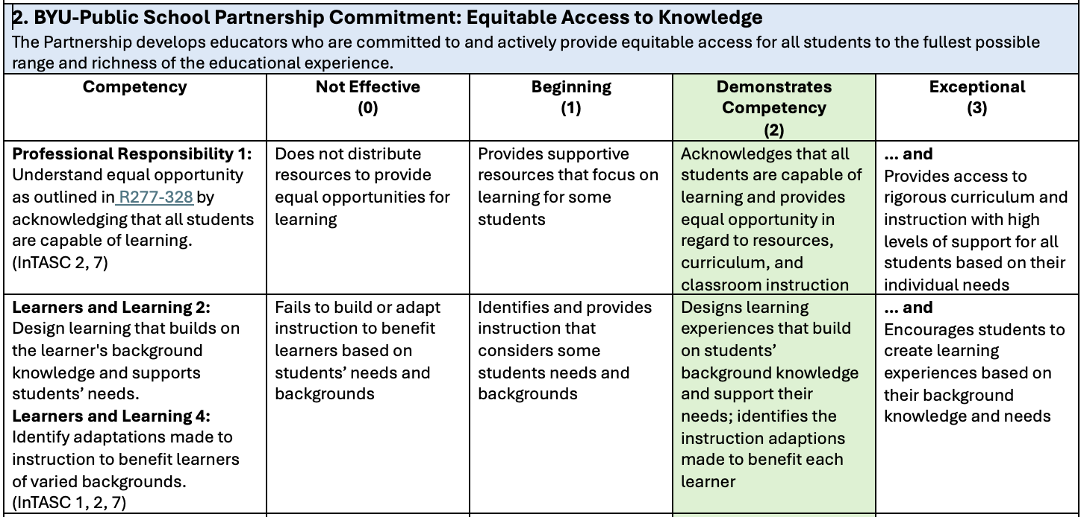
Educator System
The process is comparable to filling out a PAES
When scoring the competencies you will click the column for the score you wish to give (0, 1, 2, or 3)

Slide 18
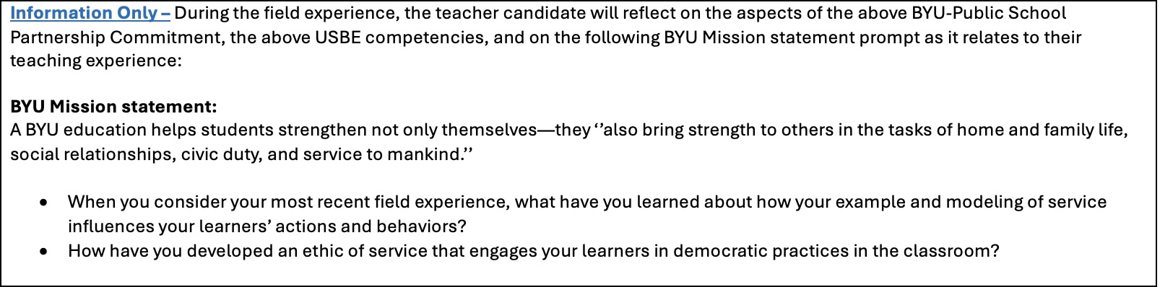
Educator System (continued)
In Educator the post-teaching discussion is recorded. This will be recorded in each of the five BYU-Public School Partnership sections.
The first box following the competencies is for Information Only. No action is required of the mentor teacher or university supervisor. This box is strictly information on what the teacher candidate is being asked to reflect on.

Slide 19
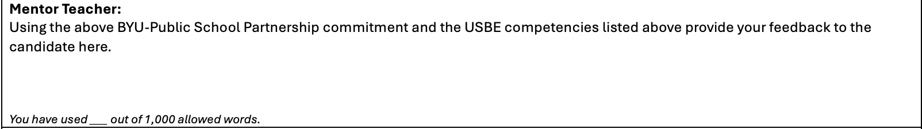
Educator System (continued)
In the next box the Mentor Teacher will respond to the Post-teaching discussion prompt and record feedback for the teacher candidate. Feedback will be provided on the BYU-Public School Partnership commitment and USBE competencies. The Mentor will not need to comment on the BYU Mission.

Slide 20
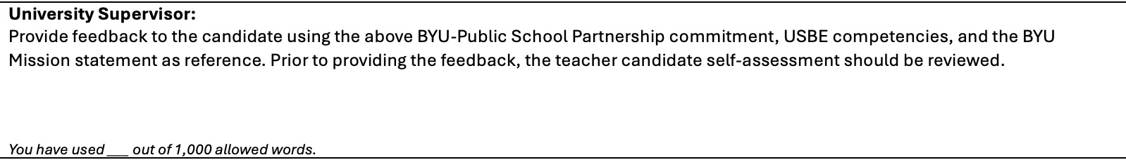
Educator System (continued)
In the final box the University Supervisor will respond and record feedback for the teacher candidate regarding the BYU-Public School Partnership commitment, USBE competencies, and the BYU Mission statement.

Slide 21
Educator System (continued)
The Teacher Candidate will fill out a self evaluation using the TCA at the end of their final field experience (e.g., student teaching or internship). They will mark the extent to which they feel they have met the competencies. At the end of each section, they will reflect on the aspects of the BYU-Public School Partnership Commitments and the competencies as it relates to their teaching experience and the Mission of BYU.

Slide 22
Group Breakout
In small groups, review the indicators of the TCA
Make a list of examples of what each indicator could look like in your program
Pay particular attention to the Demonstrates Competency (2) Column

Slide 23
Whole Group Share Out
Small groups will share a few examples of what the indicators could look like

Slide 24
What Questions Do You Have?

Slide 25
BYU Educator Preparation Program Contact Information
Brent W. Chowen, PhD
Director, Educator Preparation Program
Teaching Professor, McKay School of Education
Brigham Young University
bchowen@byu.edu
Terri L. Summers
Educator Preparation Program (EPP) Associate Director
Office of the Associate Academic Vice President
Brigham Young University
terri_summers@byu.edu
2004 JKB
Brigham Young University
Provo, UT 84602
Office: (801) 422-1190
Terri Cell: (801) 419-2187

